Slide 2
Launching the February 2015 publication of the
Revised GUIDE TO THE STANDARD:
highlighting what is newly revised and approved by the Consortium Board
University of Derby, ICEGS
February 25th 2015

Slide 3
The Quality in Careers Consortium Board (As at 12th January 2015):
Dr Barrie Hopson (succeeding founding Chair, Dame Ruth Silver) as Chair
Association of Colleges (AoC) nominee = Joy Mercer, Director of Policy (Education)
Association of Employment & Learning Providers (AELP) nominee = Stella Turner (on behalf of the AELP Board of Directors)
Association of School & College Leaders (ASCL) nominee = Duncan Baldwin, Deputy Policy Director (and as substitute = Karleen Dowden, consultant who leads for ASCL on careers guidance and apprenticeships)
Career Development Institute (CDI) ‘careers adviser’ nominee = Jan Ellis
Career Development Institute (CDI) ‘careers educator’ nominee = Sue Barr
Careers England (CE) nominee = Virginia Isaac, Chair of the CE Quality Task Group
CEIAG Expert invitee = David Andrews (CEIAG Consultant)
Higher Education Liaison Officers’ Association (HELOA) invitee = Rachel Lister of University of Cambridge (HELOA UK Vice Chair) (and as substitute = Amandip Bisel of Aston University)
National Association of Head Teachers (NAHT) nominee = Sion Humphreys, Assistant Secretary (Secondary) (and as substitute = Louis Coiffait)
Quality in Careers Standard Director & Organising Secretary for the Consortium = Paul Chubb (CEIAG Consultant)
*************************************************************

Slide 4
What is The Quality in Careers Standard? (new introduction)
The Quality in Careers Consortium owns and oversees the Quality in Careers Standard which provides national validation for England’s range of Quality Awards for careers education, information, advice and guidance (CEIAG).
The Standard is governed by the Quality in Careers Consortium Board.
3. To gain the Standard, Quality Award providers must furnish sufficient current evidence to demonstrate that they meet national validation criteria in three areas:
Criteria, content and coverage of the CEIAG Award
Assessment processes for the CEIAG Award
Management of the CEIAG Award

Slide 5
National Validation Criteria (there were 16, there now are 15) New Introduction here
1. Criteria, content and coverage of the CEIAG Award
All CEIAG Quality Award providers must supply evidence showing how their Award covers and supports:
the delivery of the core principles and themes of equality and diversity, participation and progression, raising aspirations, promoting social mobility and linking with work-related learning
the promotion by learning providers (i.e. schools, colleges and work-based learning providers) of CEIAG within the curriculum.
New footnote: This is to incorporate the need to address concerns about social mobility, inclusion, sustained destinations, qualification achievement rates and students being enabled to make successful next steps. Under ‘leadership & management’ in the revised Ofsted ‘School Inspection Framework’ (September 2014), Inspectors are tasked to explore “the extent to which the school has developed and implemented a strategy for ensuring that all pupils in Years 8 to 13 receive effective careers guidance” (para. 154).

Slide 7
THE EDUCATION ACT 2011 – essential never to forget how the new Statutory Duty for Schools to ‘secure access to independent careers guidance’ is phrased on FACE OF THE ACT: our concern is “what is meant though by ‘careers guidance’?”
[5] Careers Guidance Provided To Pupils At A School Is Independent For The Purposes Of This Section If It Is Provided Other Than By—
(A) A Teacher Employed Or Engaged At The School, Or
(B) Any Other Person Employed At The School
The Act therefore requires SCHOOLS to be COMMISSIONERS of Careers Guidance not providers of it (that’s not to say they will not provide SOME of it, but the DUTY is to secure external Careers Guidance in addition to whatever a school provides internally)
Notes:
7

Slide 8
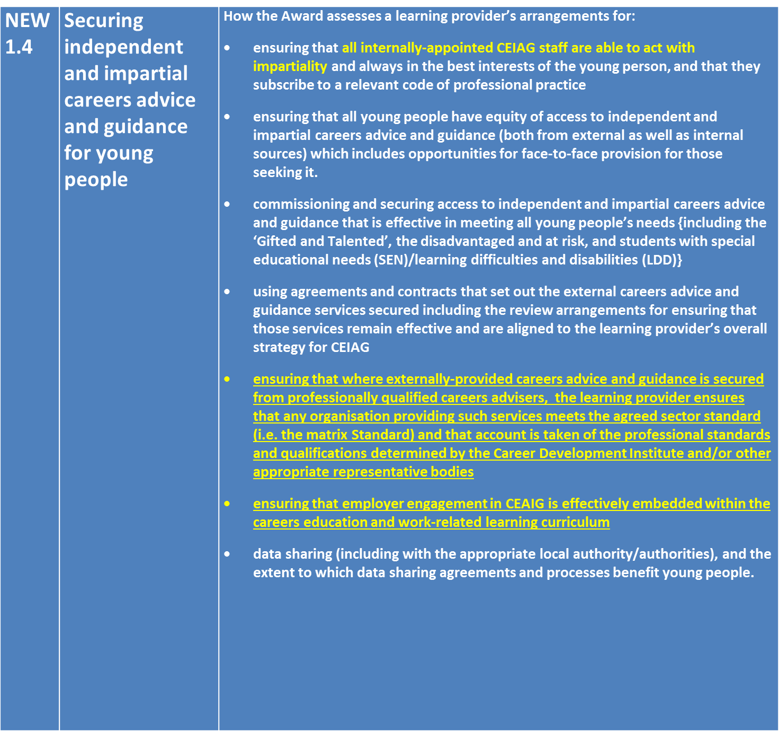

Slide 10
THREE MORE NEW FOOTNOTES TO NVC 1.4:
2. We expect Quality Award providers to stress to schools and colleges that
all staff need to act with impartiality,
and where the learning provider appoints a ‘careers adviser’ to its staff,
the Quality Award provider must satisfy itself that
the adviser is qualified to QCF L6,
is registered with the Career Development Institute,
complies with the CDI code of ethics
and maintains his/her annual CPD requirements.

Slide 11
3. Please also note that at the National Validation Panel,
if the CEIAG Quality Award has been awarded to one or more schools
which have ONLY appointed a ‘careers adviser’
without additional access contractually secured from an external professionally qualified careers adviser as well,
the NVP will require one such school to be part of
the Award provider’s team attending the Panel
so that the Panel can satisfy itself that
all of the tests of sufficiency expected in respect of NVC 1.4 are met.
Where the learning provider appoints a ‘careers adviser’ to its staff,
the Quality Award provider must satisfy itself that
young people confirm equity of access to external provision if they seek it.

Slide 12
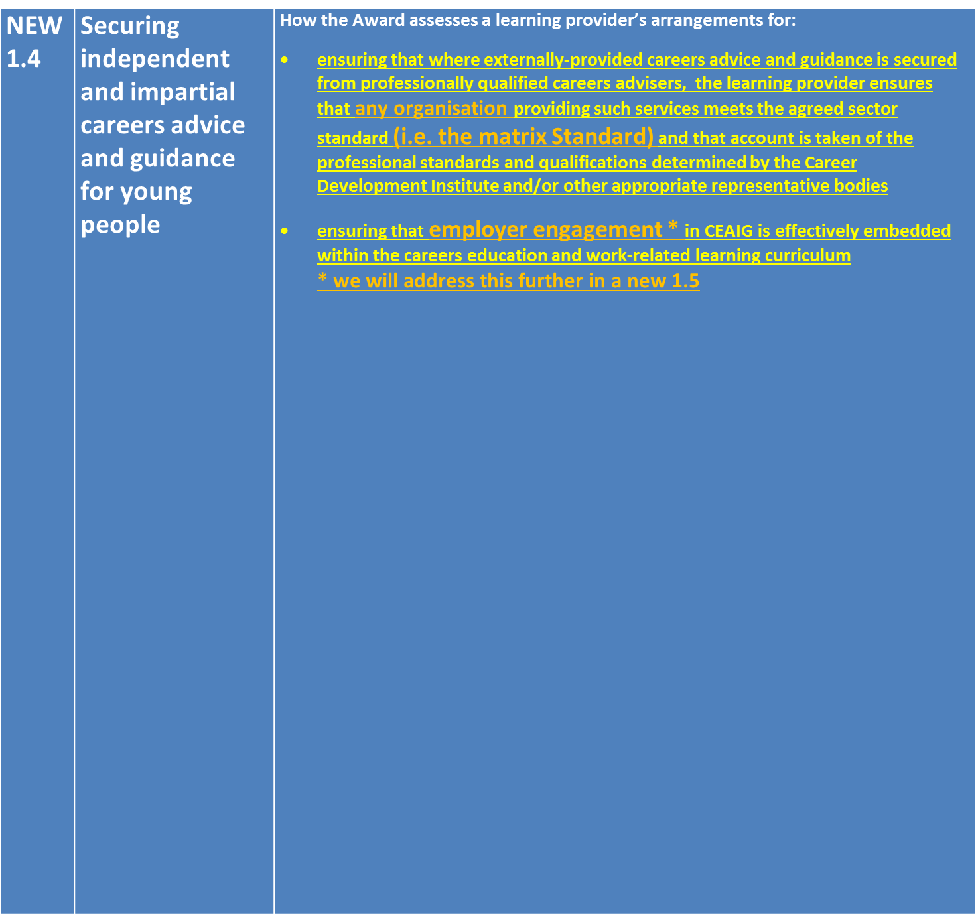

Slide 13
THE ISSUE OF SOLE-TRADERS & MATRIX ACCREDITATION
4. Whilst every organisation providing professional careers advice and guidance should be expected to hold (or be working towards achieving) the matrix Standard,
it is accepted that there will be ‘careers advisers’ working as sole-traders/in small partnerships/cooperatives, for whom it is not expected that they must be matrix accredited;
^{however,}
there are growing numbers of sole traders/small partnerships which are matrix accredited, and we would hope Quality Award providers
would encourage learning providers
securing services from sole traders/small partnerships
to encourage these to contact emqc
(the awarding body for the matrix Standard: www.emqc.co.uk)
to consider matrix accreditation.
We would expect sole traders to meet the CDI requirements and to be registered.

Slide 17
Launching the February 2015 publication of the
Revised GUIDE TO THE STANDARD:
highlighting what is newly revised and approved by the Consortium Board
University of Derby, ICEGS
February 25th 2015

